Slide 1

ActiveState Redshift data warehouse

Slide 2
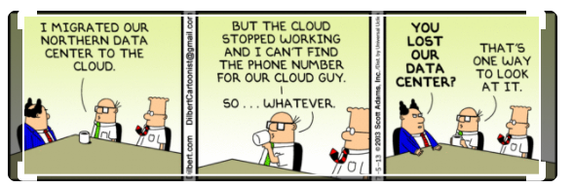

Slide 3
Decisions for data warehouse
Scalability
Cost
Analytics
Logging
Ability to query in standard language

Slide 4
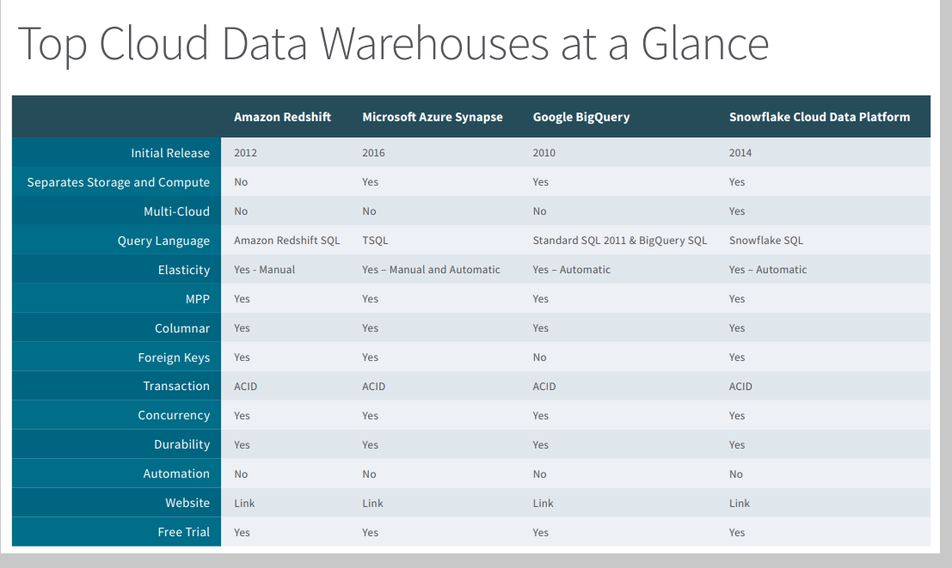

Slide 5
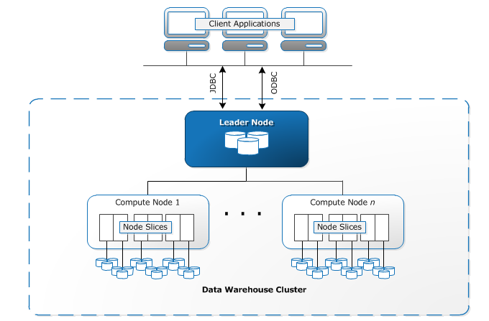
Redshift Scalability
The core warehouse infrastructure component of an Amazon Redshift data is a cluster.
The leader node manages communications with client programs and all communication with compute nodes
Each computer node has its own dedicated CPU, memory, and attached disk storage, which are determined by the node type. As your workload grows, you can increase the compute capacity and storage capacity of a cluster by increasing the number of nodes, upgrading the node type, or both.

Slide 6
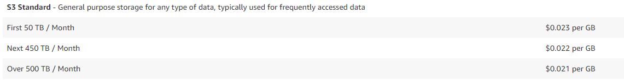
Cost
With Redshift Spectrum, you are billed per terabyte of data scanned, rounded up to the next megabyte, with a 10 megabyte minimum per query. For example, if you scan 10 gigabytes of data, you will be charged $0.05. If you scan 1 terabyte of data, you will be charged $5.00.

Slide 7
Analytics
Redshift supports the standard analytic tools.
Power BI
SAS
Tableau
SPSS

Slide 8
Redshift query
Amazon Redshift supports SQL client tools connecting through Java Database Connectivity (JDBC) and Open Database Connectivity (ODBC)
You can use most SQL client tools that support JDBC or ODBC drivers.
Since standard SQL statement are used it is easy for a teem to be up and running in no time
create table shoes( shoetype varchar (10), color varchar(10));
insert into shoes values ('loafers', 'brown'), ('sandals', 'black’);
select * from shoes;
Shoe type | Color
sandals | black
loafers | brown

Slide 9
logging
You can collect monitoring data from all the parts of your AWS solution so that you can more easily debug a multi-point failure if one occurs
Amazon Redshift is integrated with AWS CloudTrail, a service that provides a record of actions taken by a user, role, or an AWS service in Amazon Redshift. CloudTrail captures all API calls for Amazon Redshift as events.

